Slide 1


Introduction to EAST PMG Leadership and Structure
John J. Como, MD, MPH, FACS, FCCM
MetroHealth Medical Center
Cleveland, OH
@johnjcomo
2019 Annual EAST Meeting
January 15, 2019

Slide 2

Disclosures
Nothing to disclose

Slide 3

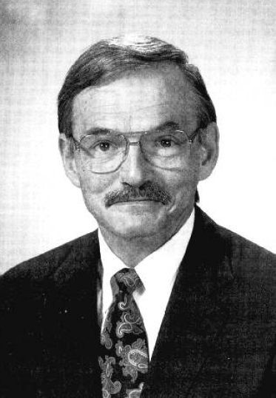
EAST PMGs
EAST was an early leader in evidence based medicine for trauma
In 1994, EAST president Michael Rhodes gave his presidential address entitled “Practice Management Guidelines for Trauma Care”
  Created the EAST Practice Management Guidelines Committee

Slide 4
My role with EAST PMGs
Attended my first EAST meeting in 2003
EAST PMG ad hoc committee meeting
  TL spine fracture
  Timing of tracheostomy
  Trauma in pregnancy
EAST has grown and matured since then
So has the EAST Guidelines Committee

Slide 5

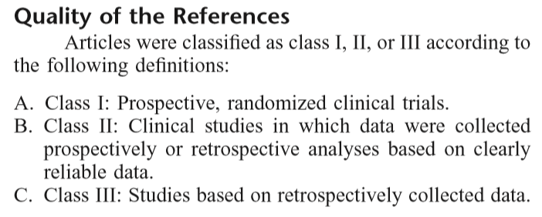
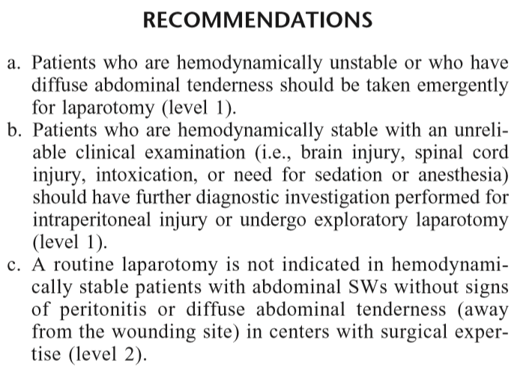
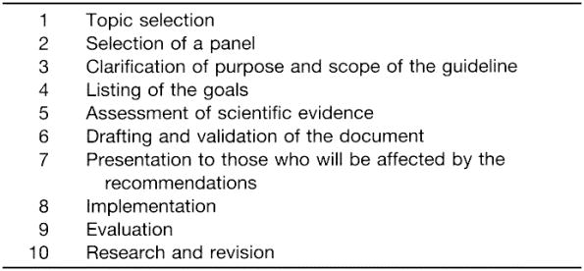
2009-2010
Identification of cervical spine injuries (2009)
Selective nonoperative management of penetrating abdominal trauma (2010)

Slide 6

2011-2012
2011 – PMG Committee divided into 4 Task Forces
Supplement to J Trauma published in November 2012
In 2012, GRADE adopted
  All subsequent guidelines have used GRADE methodology

Slide 7
Current leadership
Guidelines Committee Chair – John J. Como, MD, MPH
Task Force Chairs
  Emergency General Surgery – Nicole Fox, MD, MPH
  Injury Prevention – Rishi Rattan, MD
  Surgical Critical Care – Brian H. Williams, MD
  Trauma – George Kasotakis, MD, MPH

Slide 8

2012-present
Blunt aortic injury
Cervical spine clearance in the obtunded patient
Damage control resuscitation
Diaphragmatic injury
Emergency department thoracotomy
Femur fracture fixation timing
Pancreatic injuries
Prehospital spine immobilization
Rectal injuries
Rib fracture fixation

Slide 9
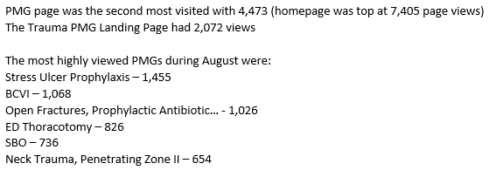
EAST Website - Guidelines

Slide 10
Currently on website
https://www.east.org/
EGS – Total 5; GRADE 4
Injury Prevention – Total 11; GRADE 7
Surgical Critical Care – Total 27; GRADE 4
Trauma – Total 36; GRADE 10
TOTAL – 79; GRADE 25
Archived 34

Slide 11
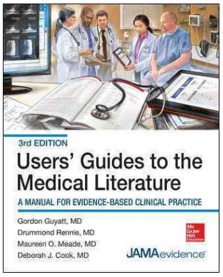
Educational materials
EAST Guide on How to Write a Practice Management Guideline (white paper)
The EAST Approach to guideline development using the GRADE methodology
GRADE YouTube videos
Attendance at US GRADE Network courses
GRADE Working Group website
Internal Education at annual EAST meeting (starting January 2019)

Slide 12
Internal Education at annual EAST meeting
Introduction to EAST PMG leadership and structure (Como)
General GRADE Overview (Robinson)
Steps and Timing of PMG Generation in EAST (Kasotakis)
Selection of Topic/PICO question generation (N. Patel/Asfaw)
Literature Search, Review, and Abstraction/Quality of Evidence (Rattan/Bauman)
Intro to Meta-Analysis and RevMan (McDonald/Sawhney)
Intro to Evidence Grading and GRADEpro (Fox/Kim)
Creating Recommendations and the Manuscript (Lunde)

Slide 13
Traumacasts (How to?)
The PMG committee has made a series of 9 videos
  Education using the GRADE methodology
  On YouTube https://www.youtube.com/watch?v=DKULStD1Aac&list=PLb_qu6L1kwWrP8Eu8dC7NXeFCh0kAxJdp&index=2

Slide 14
Published 2018 (n=7)
Monitoring modalities and assessment of fluid status
Pre-hospital spine immobilization
Prevention of firearm injuries
Prevention of all-terrain vehicle injuries
Prevention of sports-related concussions
Timing of debridement of NSTI
Traumatic diaphragm injuries

Slide 15
Accepted 2019 (n=4)
Colon trauma
Bladder trauma
Geriatric Trauma – Palliative and Trauma Center Care
Pediatric Renal Trauma

Slide 16
Currently under development
Total of 31
  EGS – 7
  Injury prevention – 5
  Surgical critical care – 7
  Trauma – 11
  Of these 3 are in internal blinded review or being reviewed by J Trauma
    Affordable Care Act
    Appendicitis
    Ileus

Slide 17
EAST 2019 meeting
Trauma
  Preperitoneal packing for pelvic fractures/pelvic hematoma
  Duodenal trauma
  Prophylactic antibiotics for chest tube placement
Surgical Critical Care
  Antimotility agents
Injury Prevention
  Geriatric hip fractures
  Hospital-based alcohol intervention
  Gun buyback programs
Pediatric Trauma
  Child abuse

Slide 18
Summary
The role of guidelines within EAST is extremely important
  EAST is internationally recognized as the leader in trauma practice management guidelines
New guidelines continue to be produced
Older guidelines need to be revised and updated
Other charges (education, social media, external collaboration, sponsorship of guidelines of other organizations)
We need help from all of you to continue to produce high-quality guidelines

Slide 19

Thank you!

